Slide 1
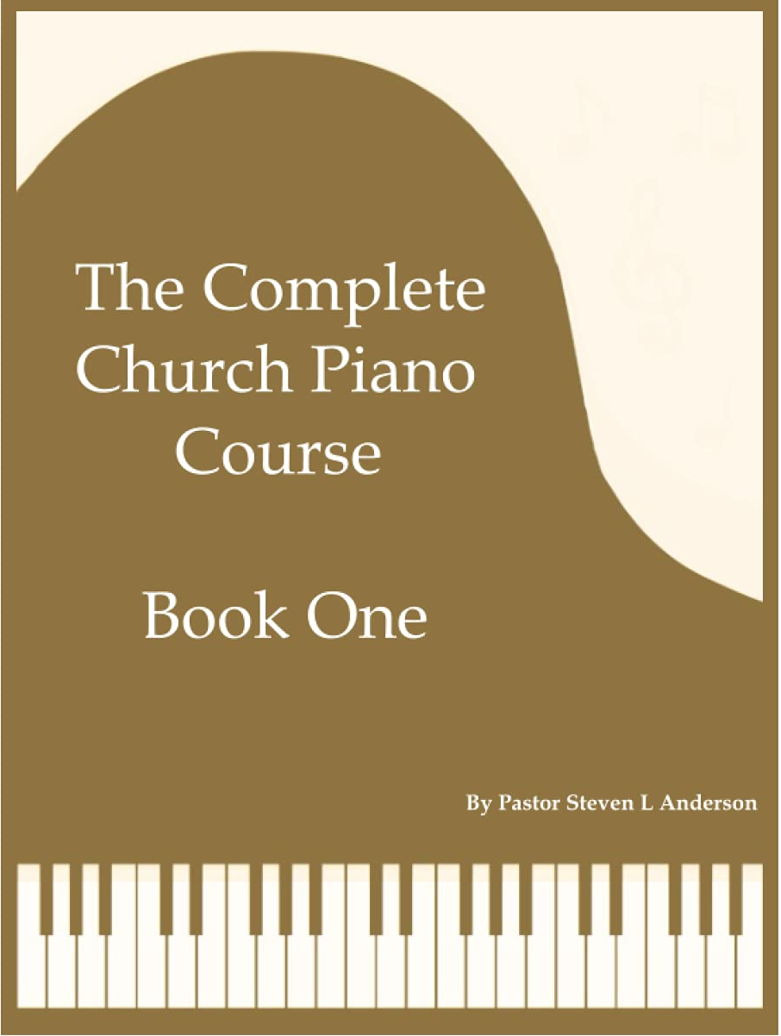

Slide 2
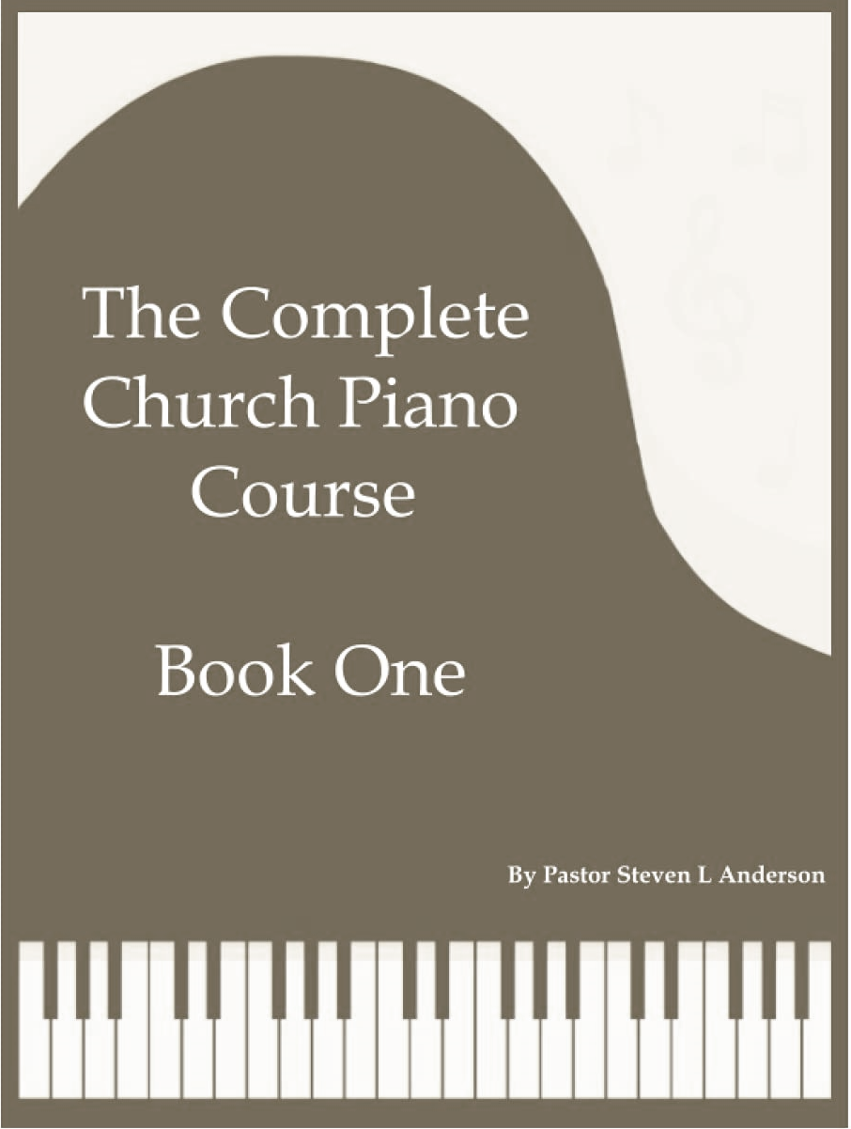
Book one

Slide 3
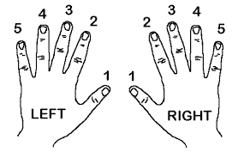
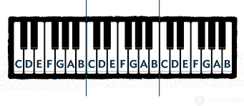
Introduction
This piano course is designed to teach the absolute beginner the skills necessary to become a church pianist.
In book One, the basics of piano and chord playing are introduced. Right from the beginning, the student will be playing bona fide hymns in their proper keys which will enable him/ her to begin playing in church immediately. All the songs in Book One are either in the key of “G” or the key of “C”.
In subsequent books, the student will learn how to play more elaborate chord patterns in the left hand, how to play in additional keys, how to play directly from the hymnal, the art of improvisation, and much more. Each book will build upon the concepts laid down in the previous book(s).
Tips on learning how to play the piano
It is much easier to learn how to play songs that you already know (i.e., you know how to sing them.) That is why famous hymns found in virtually every hymnal have been chosen for this course. If You are unfamiliar with any of the songs in this book, it is strongly recommended that you first familiarise yourself with each song before attempting to play it on the piano. This can either be done by requesting that the song be sung at your church or by searching the Internet for an audio/ video version.
2. Sing along with the song as you play, either aloud or silently in your head. This will greatly improve your timing and help you to play more naturally.
3. Do not get in the habit of looking at your hands. You should always be looking at the music in front of you with only an occasional glance at your hands. This book has been specifically designed to help you develop good habits in this area.
4. Learning how to play the piano is hard work! Although the goal of this course is to make it as easy as possible, you must be willing to invest a lot of time and energy into this course in order for it to work.
As you go through this book, you will learn how to read music. In the beginning, however, finger numbers will be used to help
you start playing right away.
1 2 3 4 5
Right Hand
Your right thumb (finger #1) will be planted on the G that is labelled with a “1.”
Your right index finger (finger#2) will be planted on the A that is labelled with “2”.
Your right middle finger ( finger #3) will be planted on the B that is labelled with a “3.”
Your right ring finger ( finger #4) will be planted on the C that is labelled with a “ 4.”
Your right pinky (finger #5) will be planted on the D that is labelled with a “5.”
NOTE: the c circled is known as “middle C” and will be located near the center of the Keyboard.

Slide 4
Your First Song
Your first song will be “Nothing but the Blood” which is eaiest song in the hymnal
Now put your left hand in the root position shown below
5 4 3 2 1 1 2 3 4 5
Left Hand Right Hanf
Hint: Your left pinky ( finger #5) will be placed on the G that is labelled with a “5,” and your left thumb ( finger #1) will be planted on the D that is labelled with a “1.”
In the left hand you will be playing “chords.” Chords are a combination of 3 or more notes played at the same time. Play the “G Chord by pressing down these 3 keys with your left hand at the same time.
Notice that there is a staff (5 parallel lines ) above the words to the song and a staff below words to the song. The notes on the upper staff are played with the right hand, and the notes on the lower staff are played with the left hand.
The numbers above the notes played by the right hand will tell you which notes to play at this stage. For example, when you see the number one, press down with your right thumb which should be on the G. When you see the number 2, press down with your right index finger which should be on the A, etc.
The capital letters about the staff brackets (G, D7, etc ) are hints to tell you which chord to play with your left hand at this point. The notes of the chord are found in the lower staff. The only two chords you will need to play “Nothing but the Blood” are the two that you have already learnt.
There are four types of notes used in this song. Songs can be played at any speed, but the types of notes used to tell you how long to hold each note relative two other notes in the song.
𝅝 Whole Note Gets 4 beats For example, hold for 2 seconds
𝅗𝅥 Half Note Gets 2 beats For example hold for 1 second
𝅘𝅥 Quarter Note Gets 1 beat For example hold for ½ second
𝅘𝅥𝅮 Eighth Note Gets ½ beat For example hold for ¼ second
Important: At this point, singing aloud will help you play the song with the proper timing
G chord
5 3 1
Next play the “D7 Chord” by pressing down the 3 keys shown below with your left hand at the same time.
D7 Chord
5 2 1
Hint : Notice that the left pinky has to move to Black key for this chord this chord

Slide 5
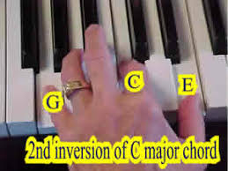
Instructions for playing “Our Great Saviour:”
You will need another Chord for this song::
When you get to the last line of the song, there is one note that is a little higher than any of the notes you have previously played in the right hand. You will have to stretch your pinky a little bit farther to the right to play this E note
𝅘𝅥. Dotted Quarter Note Gets 1 ½ beats For example, hold for ¾ second
𝅗𝅥. Dotted Half Note Gets 3 beats For example hold for 1 ½ seconds
𝅝. Dotted whole Note Gets 6 beats For example, hold for 3 seconds
Note: The only dotted notes in this song are the dotted half notes found in the left hand chords.
*Muse score

Slide 6
Our Great Saviour
*Musescore

Slide 7
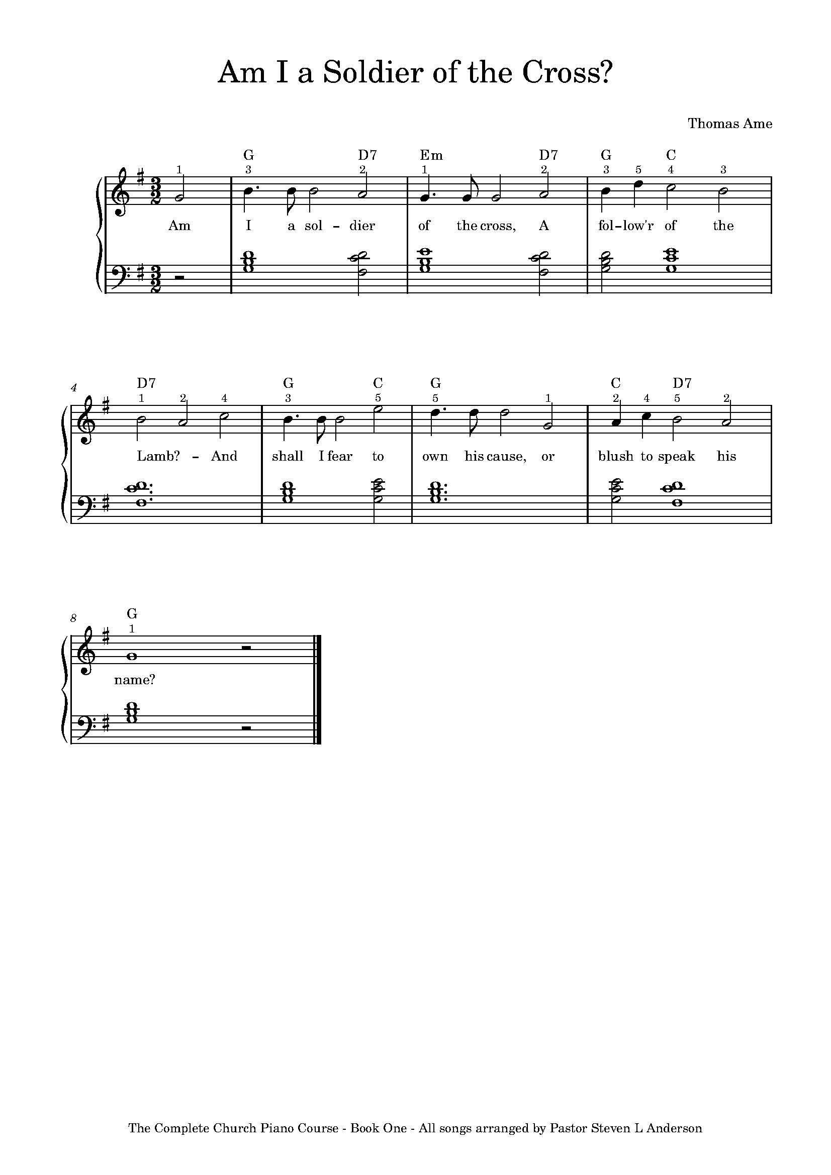
Instructions for playing “Am I a Soldier of the Cross?”
You will need another Chord for this song. So far, the chords you have learned have been “major chords.” This will be your first “minor chord,” The fact that it is a minor chord is indicated by the Lower case “m” after the “E.”
Em Chord (E minor Chord)
5
3
1
Also, this song contains another note you will have to stretch for:
Instructions for playing “When the Battle’s over”
You will need to learn a new note for this song:
𝅘𝅥𝅯 sixteenth Note Gets ¼ beat
Hint: compare the sixteenth note to the notes that you learned on page 7
The Complete Church Piano Course - Book One - All songs arranged by Pastor Steven L Anderson
*Musescore

Slide 8
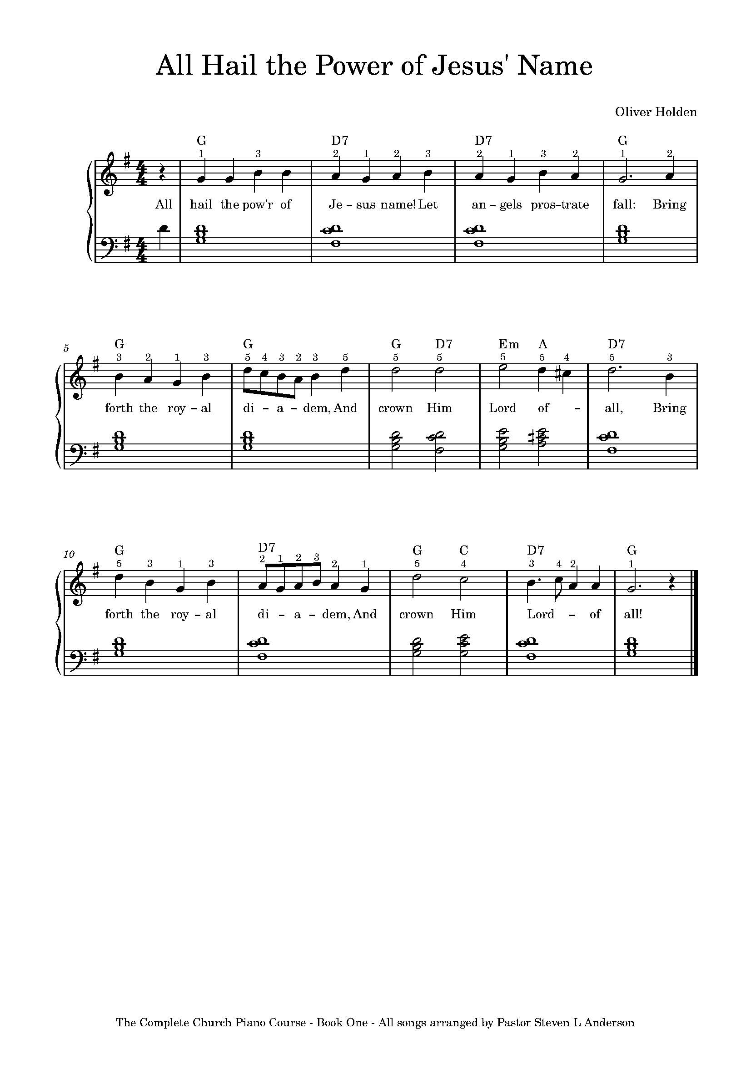
Instructions for playing “All Hail the power of Jesus’ Name”
You will need another chord for this song
A Chord
3
5
1
The other note circled above is what is called an “accidental.” An accidental is a note that has a sharp (#) or flat (b) in front of a note, play the note just lower than the written note. The Note circled above is a “C sharp.” To play the C sharp, play the black key between the C and the D with the ring finger of your right hand.
Note: The first note of the song is played with your left thumb
The Complete Church Piano Course - Book One - All songs arranged by Pastor Steven L Anderson
*Musescore

Slide 9
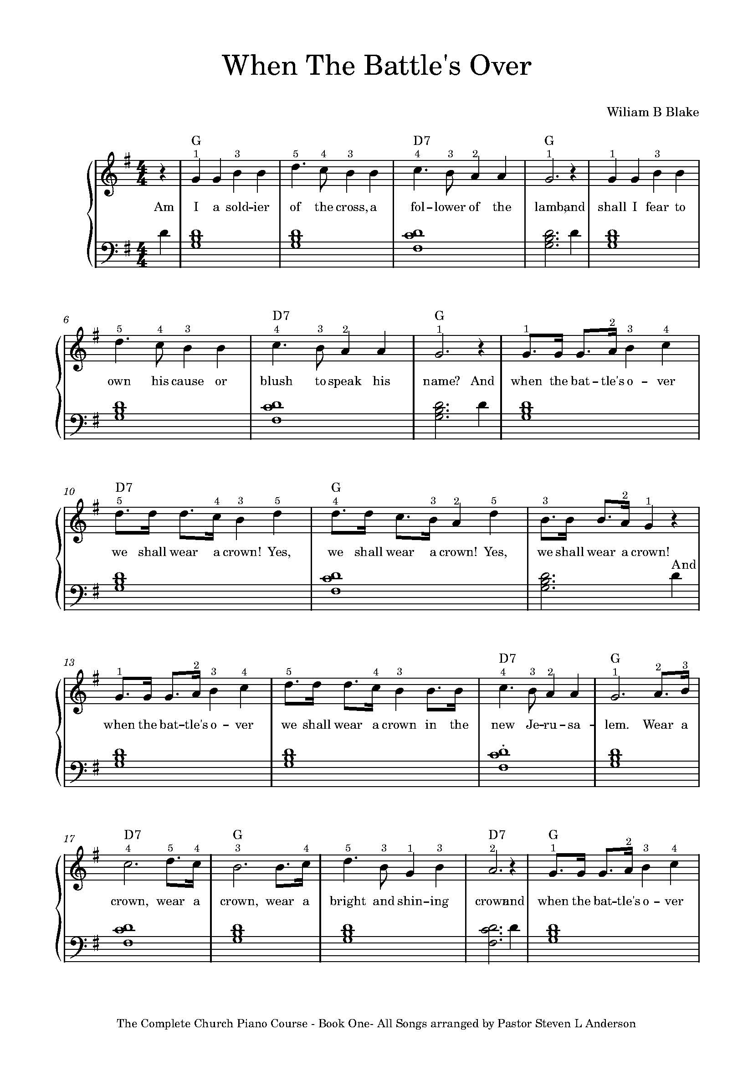
When The Battle’s Over
The Complete Church Piano Course - Book One - All songs arranged by Pastor Steven L Anderson
The Complete Church Piano Course - Book One - All songs arranged by Pastor Steven L Anderson
Click for* Musescore

Slide 10
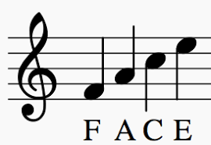
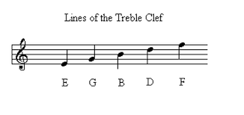
At
ur
Reading Music
Broken Chords in the Left Hand
From now on, instead of simply holding down chords with your left hand while you play the melody with your right hand, you will play “broken chords” in the left hand. To play the broken chords, press the same keys with the same fingers. However , instead of playing them all at the same time, break them up as shown below :
At this point, you will need to stop relying exclusively on the finger members to tell you which note to play and spend some time learning how to read music. Let's start with the upper staff The “treble Clef” symbol 𝄞 will help you identify the upper staff. Here are the notes of the upper staff. The first “C” shown below is middle C.
At this point, you will need to stop relying exclusively on the finger members to tell you which note to play and spend some time learning how to read music. Let's start with the upper staff The “treble Clef” symbol 𝄞 will help you identify the upper staff. Here are the notes of the upper staff. The first “C” shown below is middle C.
Notice that every other note is on a line, and every other note is on a space. Here are some tricks for learning the notes of the upper staff
Time Signatures
Here are a few time signatures that you have worked with so far:
The space notes spell the word
“face.”
The line notes form the acronym
E-G-B-D-F: Every Good Boy Does Fine”
4 beats per measure
Quarter note gets I beat
3 beats per measure
Quarter note gets 1 beat
The Vertical lines in the upper and lower staff divide the music into “measures.” The time signature determines the length of each beat
Using the Sustain Pedal
Your broken chords in the left hand will sound choppy if you do not use the sustain pedal ( the pedal on the far right). Hold down the sustain pedal throughout each measure. At the end of each measure ( every time there is a vertical line), gently release the pedal and immediately press it down again in one fluid motion.
Important: Once you have learned “Revive Us Again” with the broken chords, go back and learn “Our Saviour” with broken chords using the same technique. This pattern of broken chords will only work with songs that get 3 beats per measure..
The letters correspond to notes on the piano keyboard:
Here are the notes of the “bass clef” or lower staff. The Last note shown below is middle C.

Slide 11
At
The Key of G major
So far, every song you have learned has been in the key of G major. This is indicated by the “key signature” at the beginning of each line containing an F sharp . Here are a few examples of key signatures
C Major G Major F major D major
No Sharps (1 sharp) (1 flat) (2 sharps
The F# in the key signature for G major is indicating that every time you see an F written in the music, you need to play an F Sharp instead. The notes that make up the key of G are illustrated below in the G major “scale:”
Every key has three main chords. they are known as tonic (I) , subdominant (IV), and dominant 7th (V7). Here are the three main chords for the key of G. Notice that the Roman numerals correspond to where the G, C and D notes appears in the major scale.
I Tonic G ( 1st note of the G major Scale is G)
IV Subdominant C ( 4th note of the G major Scale is C)
V Dominant 7th D7 ( 5th note of the G major Scale is D
Instructions for playing “Grace Greater Than Our Sins:”
To play grace greater than our sin, you will have to use your right index finger to play two different notes. Read the music to know which note to play see page 18. Let your index finger cross over your thumb in order to play the F#
G A B C D E F# G
I ii iii IV V vi vii viii
1 2 3 4 5 6 7 8
The Complete Church Piano Course Book One – All songs are arranged by Pastor Steven L Anderson
2
Click for * musescore
1
2
3
4
5

Slide 12
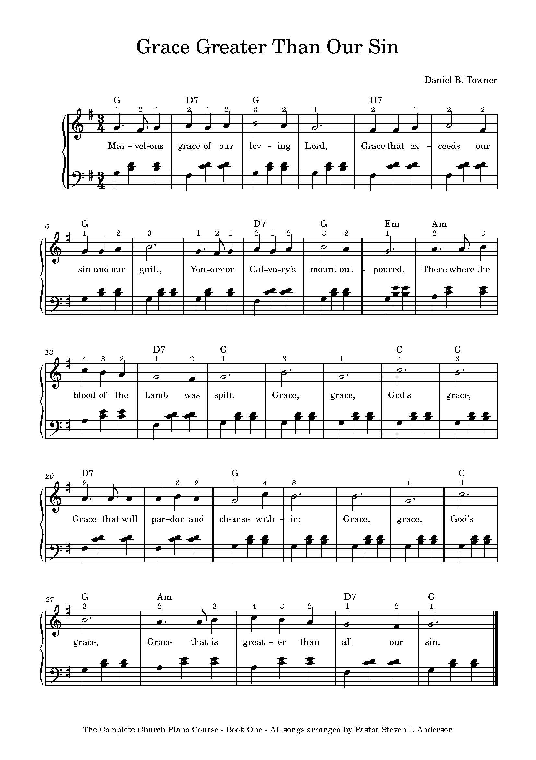
Grace Greater Than Our Sin
The Complete Church Piano Course – Book One – All songs arranged by Pastor Steven L Anderson
Click for *Musescore
The Complete Church Piano Course – Book One – All songs arranged by Pastor Steven L Anderson

Slide 13
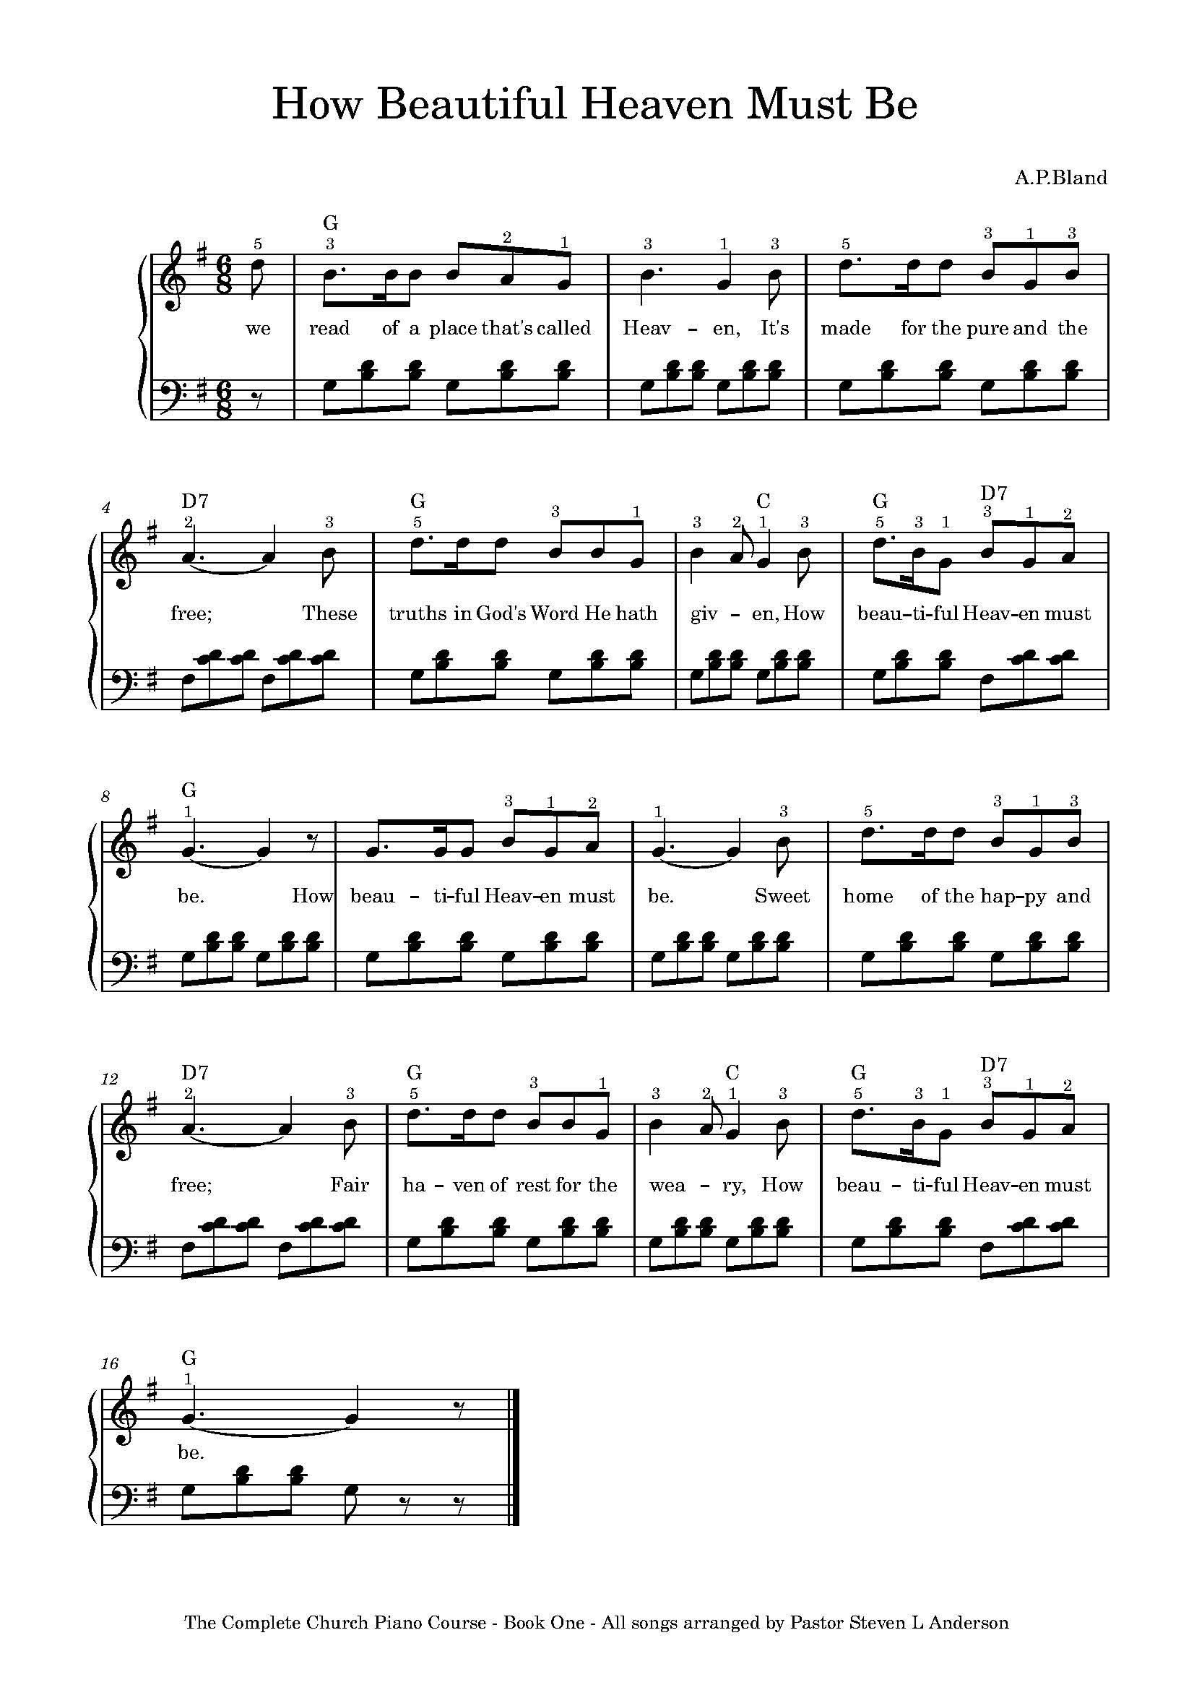
The Complete Church Piano Course – Book One – All songs arranged by Pastor Steven L Anderson
The Complete Church Piano Course – Book One – All songs arranged by Pastor Steven L Anderson
Click for *musescore

Slide 14
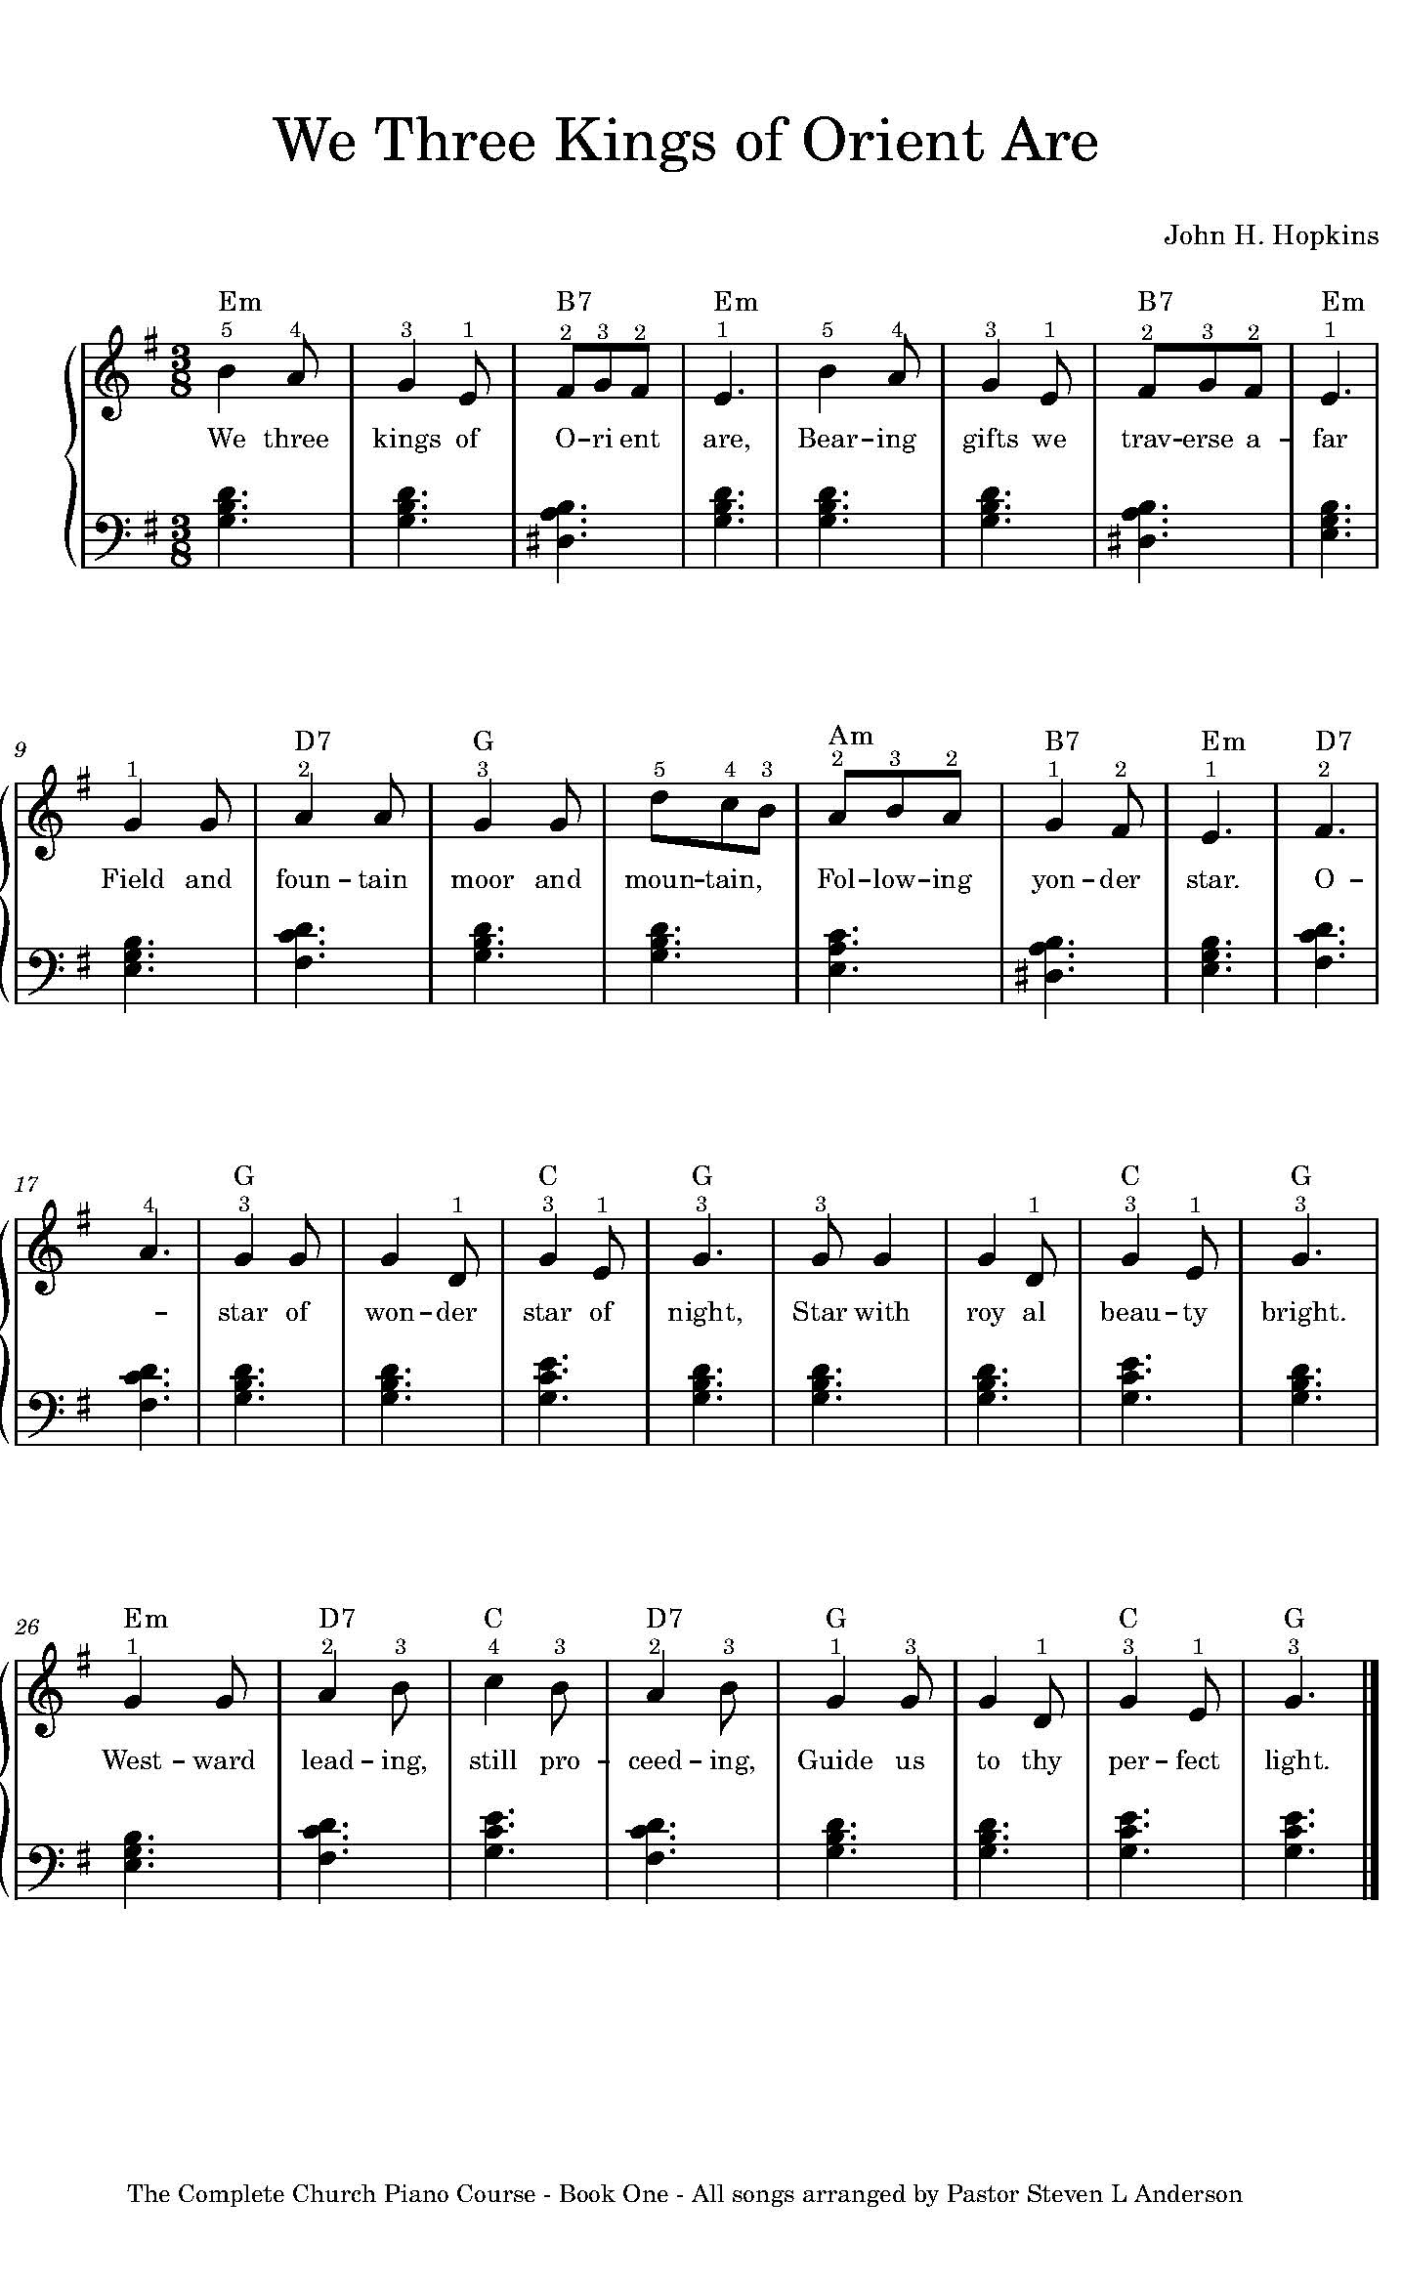
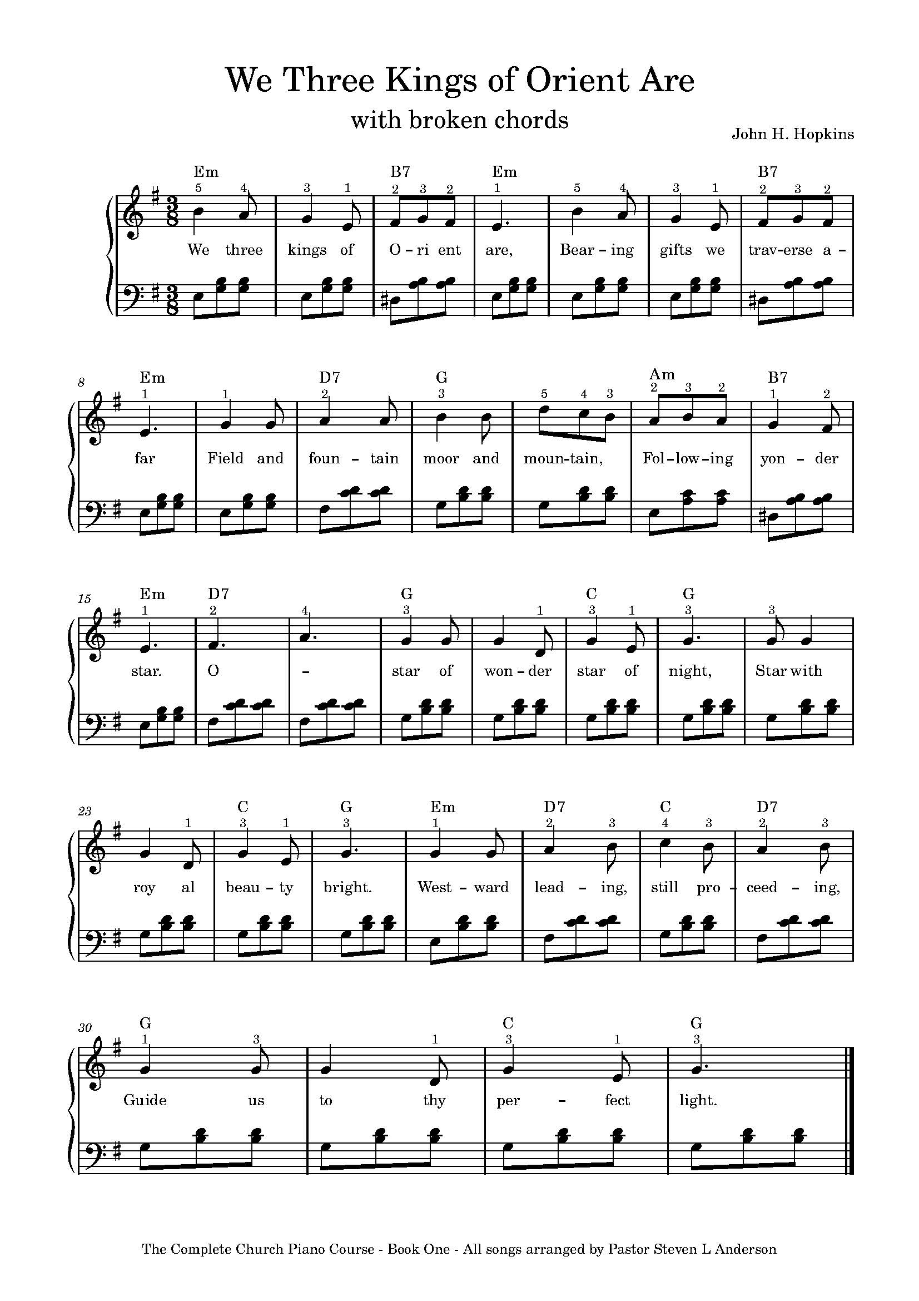
*Musescore

Slide 15
The Key of C Major
The Key of C major has no sharps and no flats
Chords in the Key of C Major
C Chord
C D E F G A B C
I ii ii IV V vi vii viii
1 2 3 4 5 6 7 8
5 3 1
Here are the three main chords of the key of C major
I Tonic C (1st note of the C major scale is C)
IV Subdominat F ( 4th note of the C major scale is F)
V Dominant 7th G7 ( 5th note of the C major scale is G)
F Chord
Right hand position for the key of C major
For the basic 5-finger position, your thumb will be on middle C, and your pinky will be on G
5 2 1
1 2 3 4 5
G7 Chord
In the song “Jesus Loves Me,” you will also need to switch into one other finger position at various points in the song. The finger numbers provided in the music will make it obvious which finger position you wil need to use throughout the song
5 2 1
1 2 3 4 5
You have already learned the C chord in previous songs, but you will play it in differten position when you are playing songs in the key of C. The finger positions for the three main chords in the key of C are shown on the following page

Slide 16
The Key of C Major
The key of C major has no sharps and no flats

Slide 17
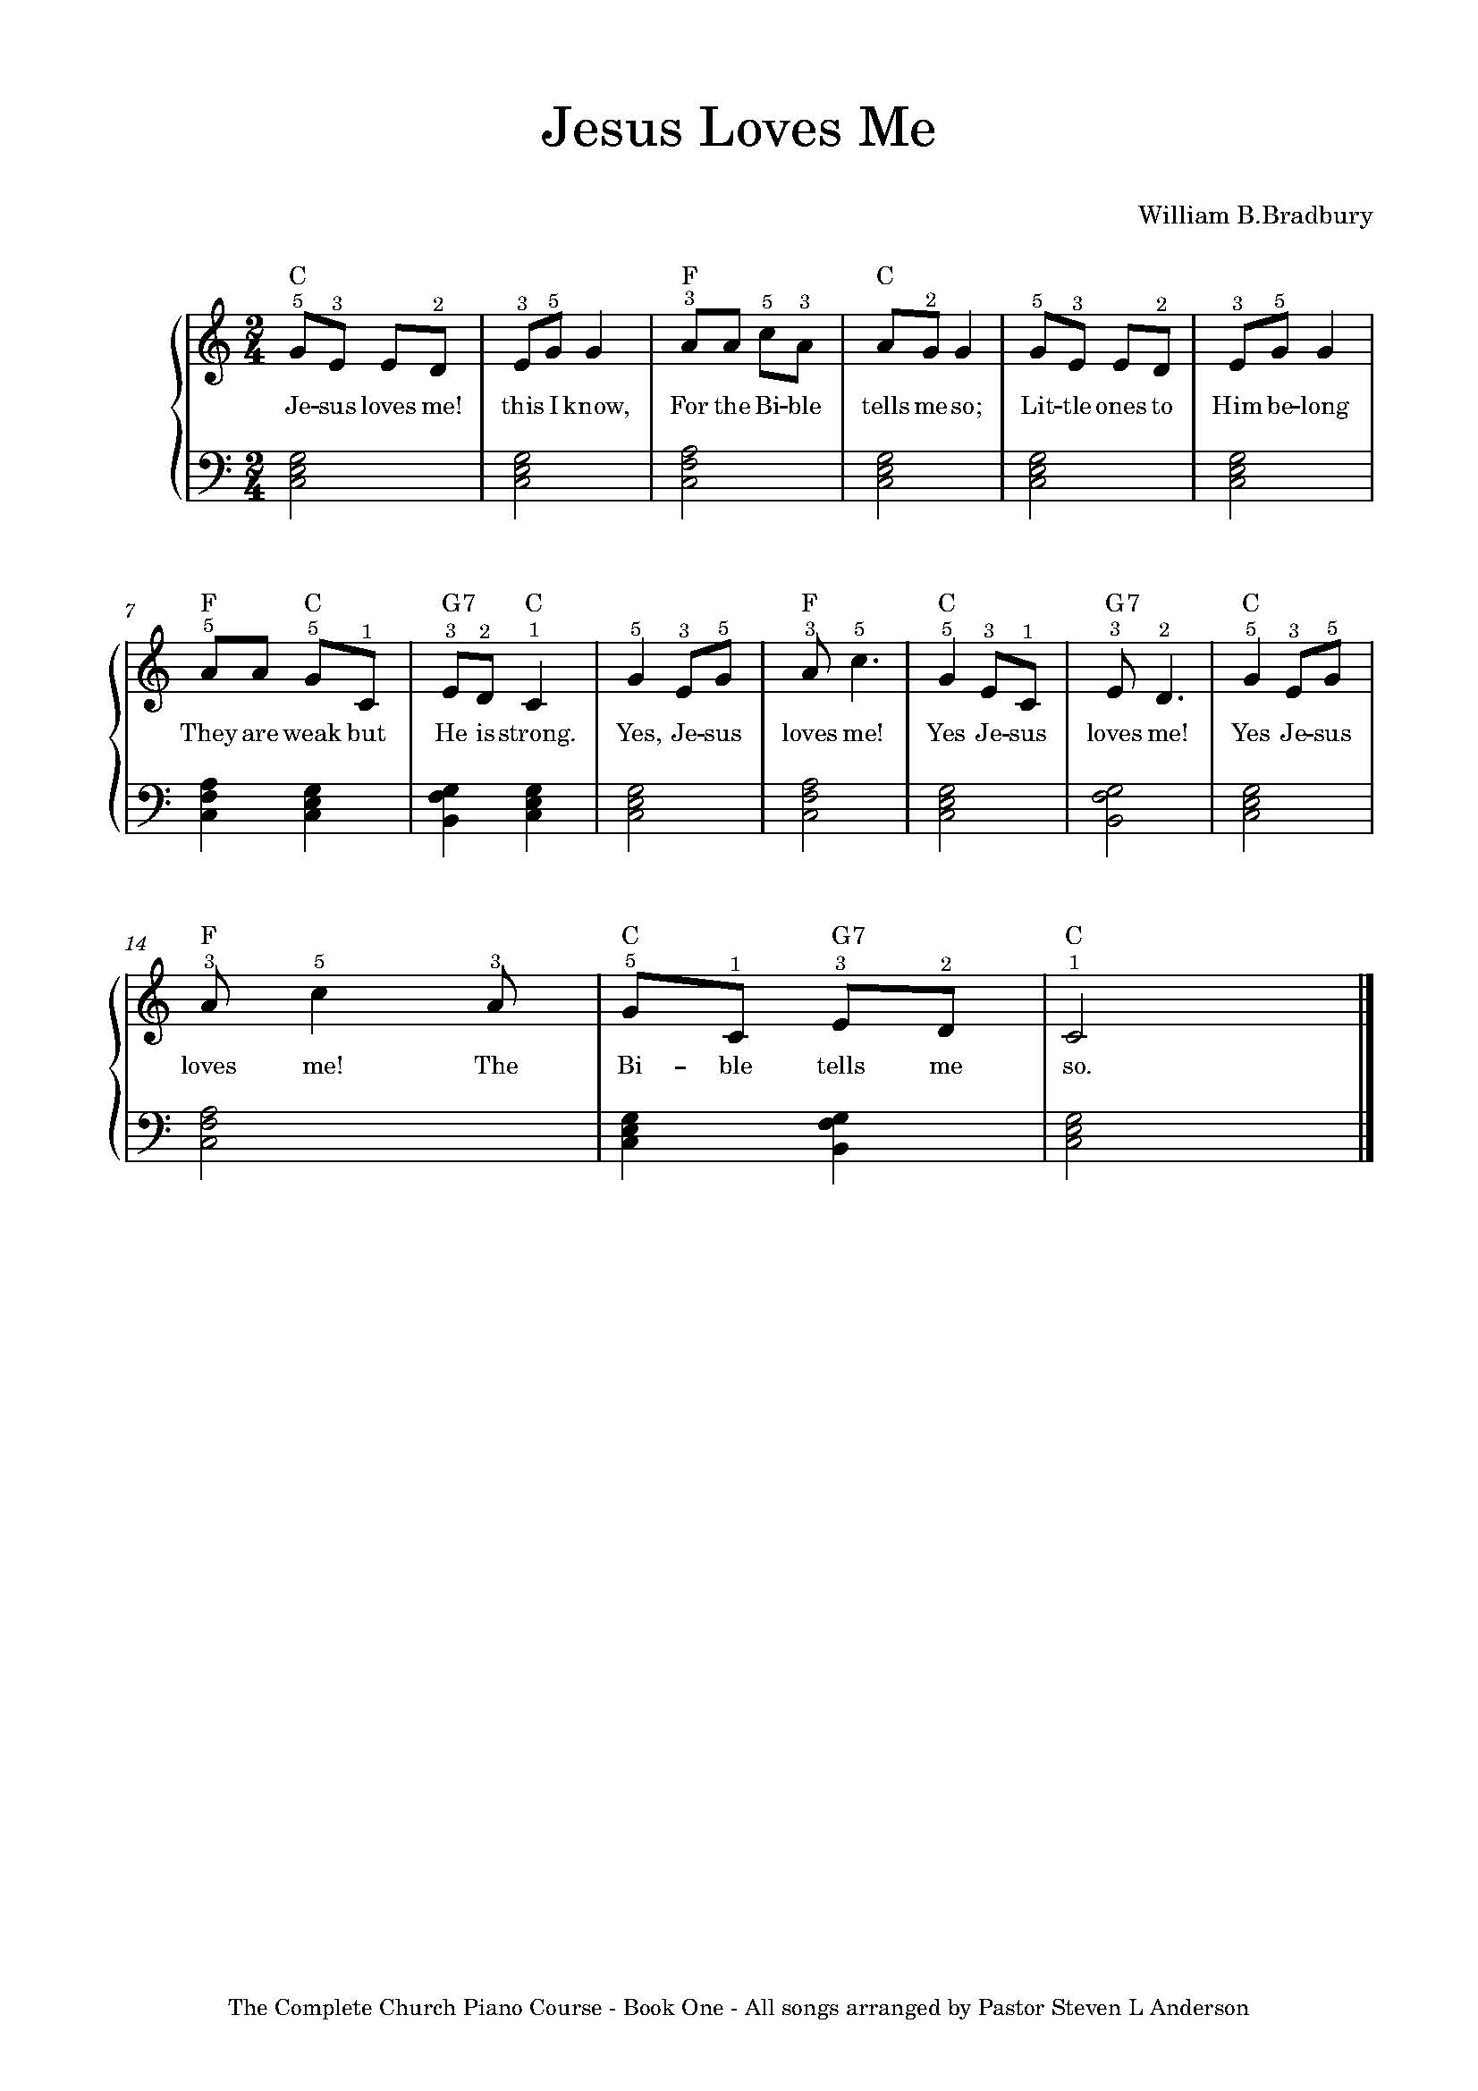
Broken Chords in the Left Hand with 4/4 Timing
With Songs that have four beats per measure, you will need to use a different broken chord pattern in the left hand
Right Hand Finger Positions for At Calvary
For the first line and half of “At Calvary” (until you get to the words “On Calvary”), your right hand will be in this position:
1 2 3 4 5
You will then hit the C note with right pinky at the word “On.” Then for the rest of the song, your right hand will remain in the following position.
The Complete Church Piano Course – Book One – All songs arranged by Pastor Steven L Anderson
1 2 3 4 5
Important: BEFORE attempting “At Calvary,” go back and play “Nothing But the Blood,” “All Hail the Power,” and “When the Battle’s Over” using the new 4/4 broken chord pattern that you have just learned.
Click
musescore

Slide 18
Instructions for playing “There is a Fountain
The right hand fingering for “There is a Fountain” is going to more difficult than any of the songs you have played up to this point. You will have to move your right hand around a lot as opposed to leaving it planted in 5- finger position. The finger numbers provided will help you.
Congratulations!
You have completed book one The Complete Church Piano Course. if you have mastered the concepts laid out in this book and successfully played all of the songs, you are ready to move on to Book two. “Sing unto him and a new song; play skillfully with a loud noise.” - Psalm 33:3 “Praise ye the LORD. Sing unto the LORD a new song, and his praise in the congregation of Saints.” - Psalm 149:1 “And these are the singers, chief of the fathers of the Levites, who remaining in the chambers were free; for they were employed in that work day and night.” - 1 chronicles 9:33 “And when they had sung an hymn, they went out into the mount of olives.” - Matthew 26:30 “Speaking to yourself in psalms and hymns and spiritual songs, singing and making melody in your heart to the Lord.” - Ephesians 5:19 “Let the word of Christ dwell in you richly in all wisdom; teaching and admonishing one another in psalms and hymns and spiritual songs , singing with grace in your hearts to the Lord” - colossians 3:16 Psalm 150
Praise ye the LORD. Praise God in His sanctuary: Praise Him in the firmament of His power. Praise Him for his mighty acts; praise Him according to His excellent greatness.
Praise Him with the sound of the trumpet: Praise Him with the psaltery and harp.
Praise him with the timbrel and dance: Praise Him with stringed instruments and organs . Praise Him upon the loud cymbols: Praise Him upon the high sounding cymbals.
Let everything that had breath Praise the LORD. Praise ye the LORD.
Click
For musescore

Slide 19
All Hail the Power of Jesus’s Name
Am I a Soldier of the Cross
At Calvary
Grace Greater Than Our Sin
How Beautiful Heaven Must Be
Jesus Loves Me
Notihing But the Blood
Our Great Saviour
Revive Us Again
There is a Fountain
We Three Kings
When the Battle’s Over

